Slide 1





Consumer goods ad_hoc Insights
Atliq hardwares
Sql project challenge
Created by Shraddha shukla

Slide 2
Agenda
Introduction to Company
Problem Statement
Ad_hoc Request and Insights

Slide 3
Introduction to company
Atliq Hardwares (imaginary company) is one of the leading computer hardware producers in India and well expanded in other countries too.
Product line of Atliq’s Business
Markets of Atliq’s Business
Domain: Consumer Goods

Slide 4
Atliq’s product line
P & A
Peripherals
Graphic card
Internal HDD
Accessories
Batteries
Keyboard
Mouse
Motherboard
Processors
PC
Desktop
Business Laptop
Personal Laptop
Notebook
Gaming Laptop
Personal Laptop
Business Laptop
N & S
Networking
Wi-Fi Extender
Storage
External SSD
USB Flash drives

Slide 5
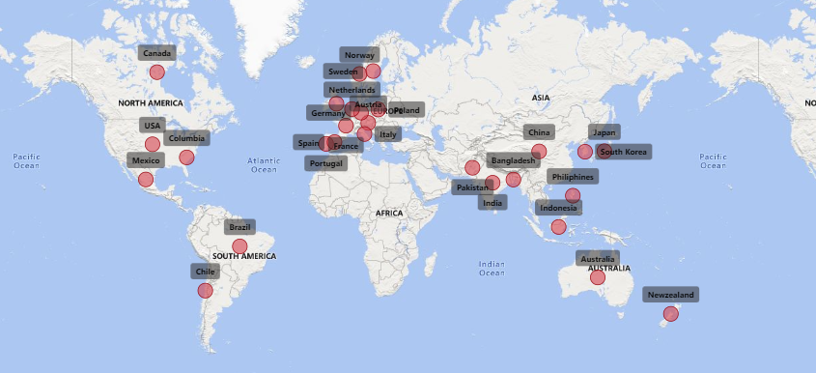
Atliq’s Markets
There are total 27 markets in which Atliq perform its business.

Slide 6

Problem statement
The management noticed that they do not get enough insights to make quick and smart data-informed decisions.
There are 10 ad hoc requests for which the business needs insights.

Slide 7

Ad_hoc request and insights
* Run a SQL query to answer these ad_hoc requests and convert these query to visualization so that it can easily understood.
* The target audience of this insights is top-level management.
* Present this insight to Top-level management of the company.

Slide 8

Ad_hoc request and insights

Slide 9
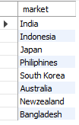
Ad_hoc request
Input
Output
Provide the list of markets in which customer "Atliq Exclusive" operates its business in the APAC region.
Request :1

Slide 10
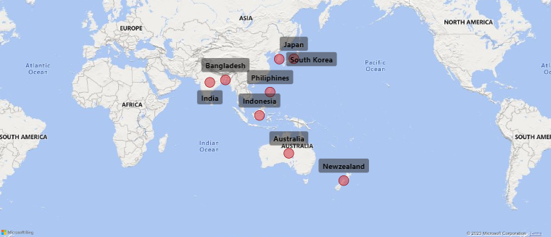
Insights
"Atliq Exclusive" operates its business in major 8 markets in APAC region.

Slide 11

Ad_hoc request
Input
Output
What is the percentage of unique product increase in 2021 vs. 2020?
The final output contains these fields, unique_products_2020
unique_products_2021
Percentage change
Request :2

Slide 12
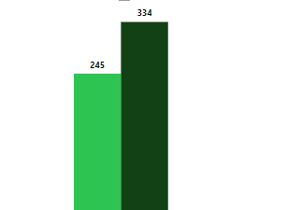
Insights
In 2020 the number of unique product were 245 and after one year in 2021 the number of unique products is increased to 334 i.e., overall 36.33% increment in the unique product which shows that Research and Development (R & D) Department of the company is performing great.
36.33%
2020
2021

Slide 13
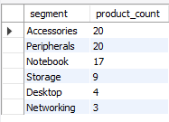
Ad_hoc request
Input
Output
* Provide a report with all the unique product counts for each segment and sort them in descending order of product counts. The final output contains 2 fields
* segment
* product_count
Request :3

Slide 14
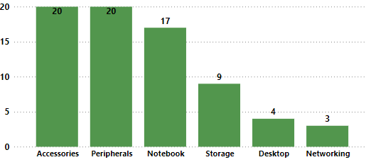
Insights
* It shows that Accessories and Peripherals have good unique product count as compared to other segments and company should focus on Desktop and Networking segment as desktop have 4 unique product and networking have only 3.
* Marketing and sales department should analyze the requirement of the customer in Desktop and Networking segment

Slide 15
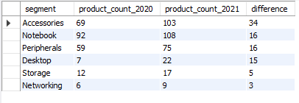
Ad_hoc request
Input
Output
Follow-up: Which segment had the most increase in unique products in 2021 vs 2020?
The final output contains these fields
segment
product_count_2020
product_count_2021
difference
Request :4

Slide 16
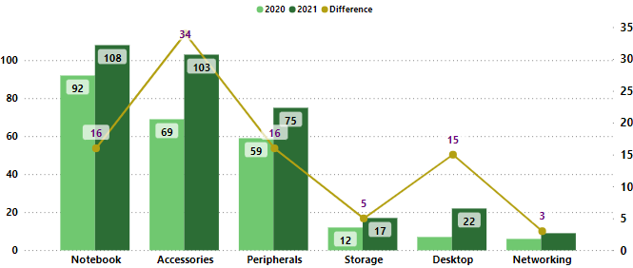
Insights
* After analyzing it shows that Accessories have most increase in unique product with 34 new products which is highest increment as compared to other segments but focusing on individual segment is not good for company .
* As there is only 3 product increment in Networking segment which is the point of concern, Research and Development department of the company should focus on this and know the exact reason behind this.

Slide 17

Ad_hoc request
Input
Output
.
Get the products that have the highest and lowest manufacturing costs.
The final output should contain these fields, product_code
product
manufacturing_cost
Request :5

Slide 18
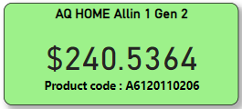
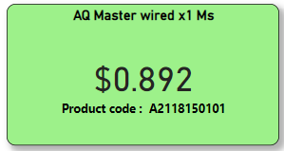
Insights
It shows that AQ Home Allin 1 Gen 2 has highest manufacturing cost which is point of concern ,either price of raw material and labour cost is high or any supply chain issue.
Highest manufacturing
cost
Lowest manufacturing
cost

Slide 19
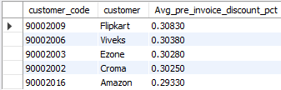
Ad_hoc request
Input
Output
.
Generate a report which contains the top 5 customers who received an average high pre_invoice_discount_pct for the fiscal year 2021 and in the Indian market.
The final output contains these fields customer_code
customer
average_discount_percentage
Request :6

Slide 20
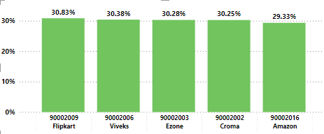
Insights
Analyzing the Average pre invoice discount percentage , it shows that Flipkart and Viveks have highest and similar average pre invoice percentage with 30.83% and other 3 customers are also having almost equal .

Slide 21
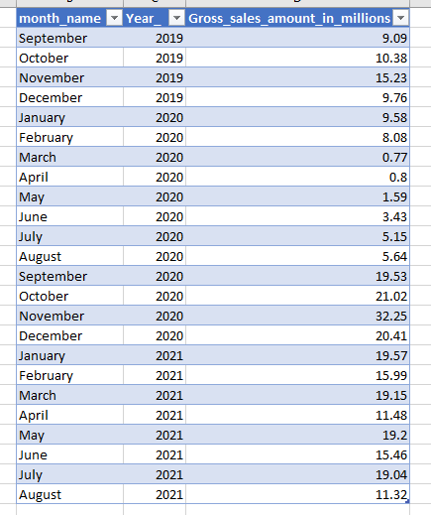
Ad_hoc request
Output
Input
.
Get the complete report of the Gross sales amount for the customer “Atliq Exclusive” for each month.
This analysis helps to get an idea of low and high-performing months and take strategic decisions. The final report contains these columns:
Month
Year
Gross sales Amount
Request :7

Slide 22
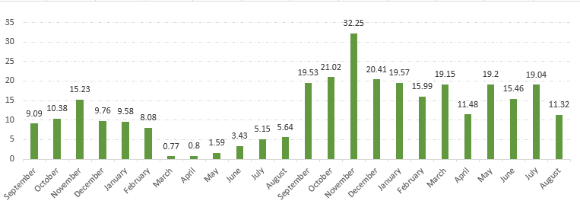
Insights
In November of FY 2021 there is highest gross sales amount with $32.25M and March 2020 shows lowest sales amount with only $0.77M but after August 2020, with starting of FY 2021 in September there is drastic increase in sales which is good for company.
FY 2020
FY 2021

Slide 23

Ad_hoc request
Input
Output
.
In which quarter of 2020, got the maximum total_sold_quantity?
The final output contains these fields sorted by the total_sold_quantity,
Quarter
total_sold_quantity
Request :8

Slide 24
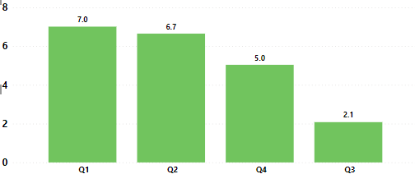
Insights
* In 2020 Quarter 1 has maximum total sold quantity with $7.0 million which shows that in September, October and November there is highest sales because Financial Year of company starts from September.
* The point of concern is sales of Quarter 3 which shows lowest sold quantity
* Marketing and Sales department should focus on Sales of Q3 know the exact reason behind this downfall of sales.

Slide 25

Ad_hoc request
Input
Output
.
Which channel helped to bring more gross sales in the fiscal year 2021 and the percentage of contribution?
The final output contains these fields,
channel
gross_sales_mln percentage
Request :9

Slide 26
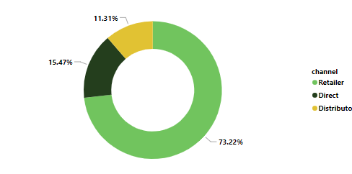
Insights
Atliq Hardware company is selling its product through three channels i.e., Retailer, Direct , Distributor and in 2021 Retailer brings the highest gross sales with 1924.17M and is contributing about 73.22% of overall gross sales of 2021 which shows that this channel is more beneficial for company as compared to other channel .
* As Distributor channel is contributing only 11.31% which is point of concern , the Distribution department should focus on this and know the exact reason behind lowest gross sales.

Slide 27
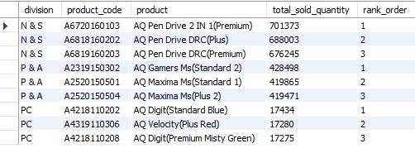
Ad_hoc request
Input
Output
.
Get the Top 3 products in each division that have a high total_sold_quantity in the fiscal_year 2021? The final output contains these fields,
Division
product_code
product total_sold_quantity
rank_order
Request :10

Slide 28
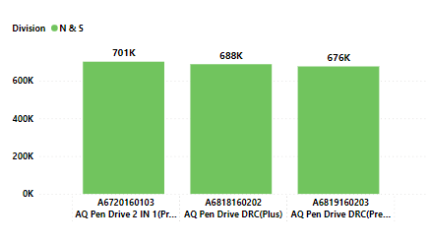
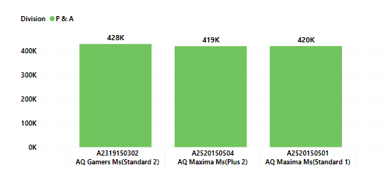
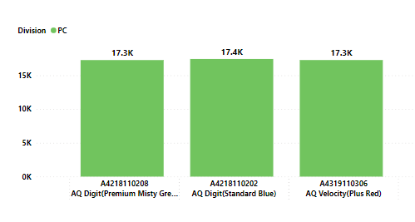
Insights
In 2021 top 3 selling product in N & S were pen drive which were about 7 lakhs in quantity
In 2021 top 3 selling product in P &A were mouse which were about 4 lakhs in quantity
In 2021 top 3 selling product in PC were personal laptop which were about 17K in quantity

Slide 29
Thank you
Atliq hardwares
Sql project challenge
Created by Shraddha shukla

